Slide 1
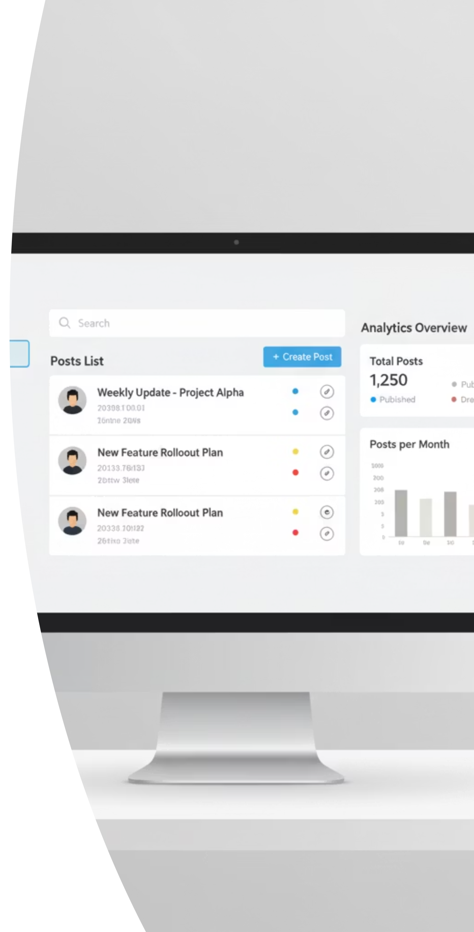
Post/Issue Management System
.

Slide 2
Project Overview & Purpose
Issue Tracking
Complaint Handling
Information Sharing
Efficiently log and manage problems like "broken office furniture."
Address concerns such as "unhygienic canteen food" systematically.
Facilitate general posts like "Lost and Found" or "Need Blood."

Slide 3





Technology Stack
Backend
Frontend
Database
ASP.NET Core 8
Angular 20.3.8, Node 24.11, npm11
SQL Server (Code-first approach)
Security
ORM
Basic Auth & JWT
EF Core

Slide 4








Detailed Layered Architecture
Presentation Layer
Manages user interaction and incoming requests. Handles UI/API endpoints, DTOs, validation, and authentication.
Application Layer
Orchestrates use cases and business workflows. Defines commands, queries, and interfaces for data persistence.
Domain Layer
Core business rules, entities, and domain logic. Pure logic, independent of technical details.
Infrastructure Layer
Provides technical implementations for interfaces. Includes data access, external APIs, logging, and security.

Slide 5
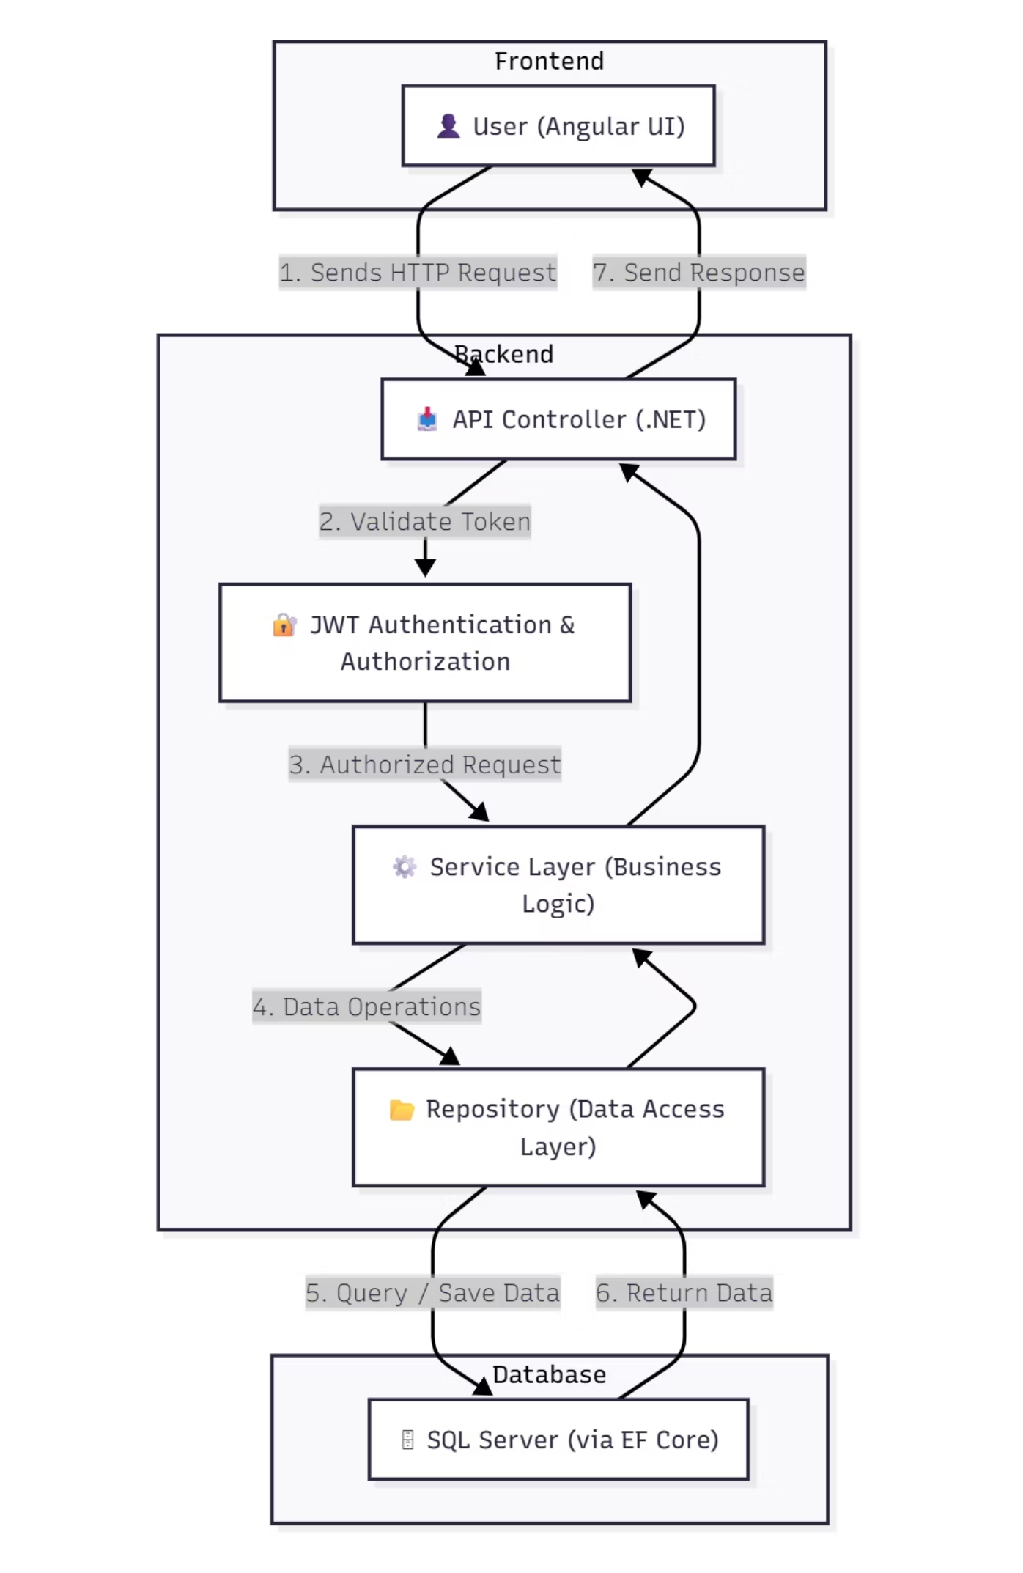
System Workflow
Request Flow Explained
Frontend Interaction: User requests from Angular UI
API Controller Routing: Entry point for all incoming requests
Security Validation: JWT Authentication and Authorization verification
Business Logic Processing: Service Layer executes core business logic
Data Abstraction: Repository Layer handles data access
Data Persistence: SQL Server stores and retrieves data

Slide 6
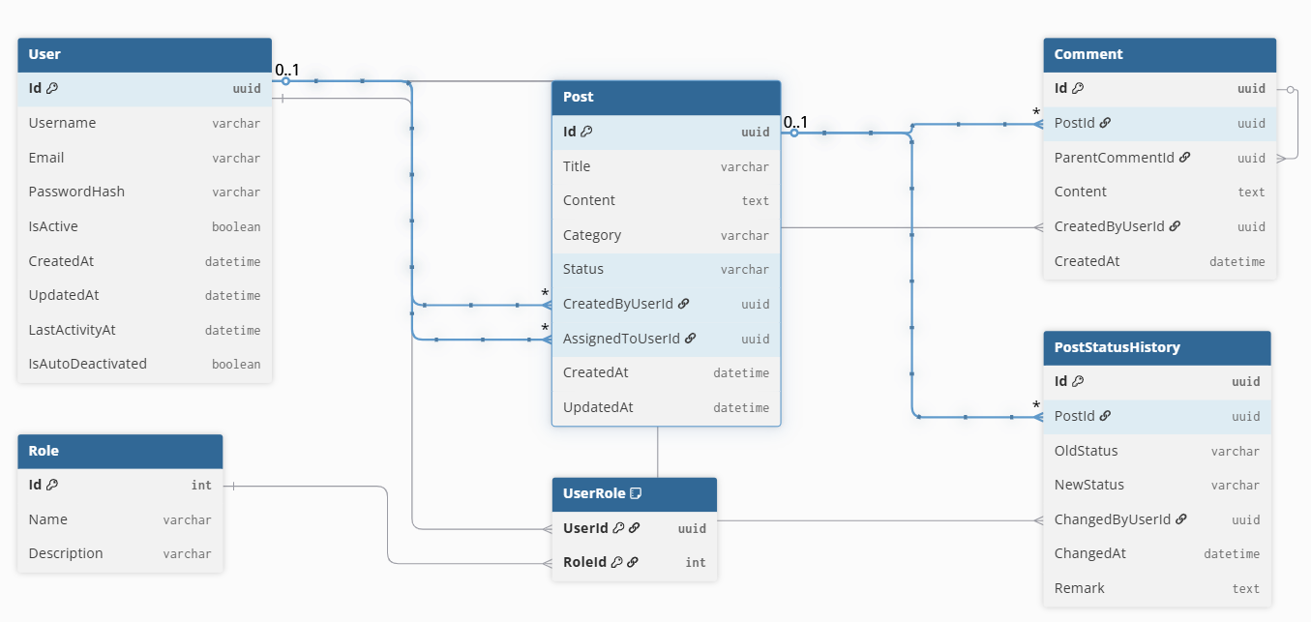
Database Schema
This ER diagram illustrates the structure of our database,
detailing the relationships between key entities and tables.
It serves as a blueprint for data organization and retrieval.

Slide 7





Roles & Access Control
Admin
Superadmin
approves, rejects, closes posts
Unique, full control
User
Create posts, view own posts, view approved public posts
Audit Records
Track role changes and account activation/deactivation
Role-Specific Dashboards
Tailored interfaces for each role

Slide 8




Post Workflow Management
Consistent status lifecycle for all posts.
DRAFT
PENDING APPROVAL
Initial creation
Submitted by User.
APPROVED
CLOSED/RESOLVED
By Admin,Superadmin
By User,Admin,Superadmin

Slide 9

Key API Endpoints
Authentication
POST /auth/register
POST /auth/login
User/Admin Management
GET /api/admin/users
POST /api/admin/users/{userid}/suspend
POST /api/admin/users/{userid}/reinstate
Posts
DELETE /api/admin/users/{userid}
GET /api/posts
POST /api/admin/users/{userid}/promote
POST /api/Posts/{id}/submit
POST /api/admin/users/{userid}/demote
GET /api/Posts/{id}
DELETE /api/Posts/{id}
Comments
POST /api/Posts/{id}/approve
POST /api/Posts/{id}/reject
POST /api/Posts/{postId}/comments
POST /api/Posts/{id}/close
GET /api/Posts/{postId}/comments

Slide 10
Project Development Challenges
Requirement Gathering and Understanding
Evolving and unclear requirements making it difficult to map real workflows accurately.
API Integration Issues
Syncing API changes with UI changes.
Database Modelling Challenges
Designing stable data relationships while maintaining integrity and managing migrations.
Entity Framework Complexities
Managing data loading, query optimization, and complex relational structures.
JWT Authentication & Authorization
Managing JWT setup, token expiry, and secure role-based access.

Slide 11
Upcoming System Enhancements
Password Reset
Advanced Post Search
Comment Ownership
Users can reset their password to a secure default for account recovery, streamlining access.
Enhanced filtering by status, type, date, creator, title, description, or post ID for all roles.
Empowering users to manage their own contributions by editing or deleting their comments.
Category-Based Assignment
CI/CD & Dockerization
Automate post assignment to relevant admins based on predefined post categories.
Implementing continuous integration, delivery, and containerization for robust deployment.

Slide 12

Conclusion
The Post/Issue Management System delivers a robust, user-friendly platform with a scalable microservices architecture, streamlining content creation, advanced search, and collaborative issue tracking for efficient operations and continuous improvement.

Slide 13

Thank You!
Appreciated your time and attention.
Any Questions?

